Slide 1
CSC 501 Operating Systems Principles

Slide 2
Instructor: Patrick Morrison
pjmorris@ncsu.edu
Office hours: Tue 4-5:45, EB2 2303C
DevOps and Project Management at IBM
NCSU PhD in 2017, “A Security Practices Evaluation Framework”
Career as a software developer…
Unix device drivers
Corporate applications in C, C++, Visual Basic, C#
SQL database design and support
Web applications

Slide 3
Teaching Assistants
Zhengyi Qiu (zqiu2@ncsu.edu)
Shudi Shao (ssha2@ncsu.edu)
Office Hours: EB2 1211F
Wednesday 4-5:30pm
Friday 3:30-5pm

Slide 4
You?
New to NCSU?
First OS course?
Experience in C programming? ARM? x86?
Read OS papers before?

Slide 5
Course Overview
Goals:
OS internals
Distributed Systems
Current trends in OS research
Structure:
Each major area:
Review basic material
Read and review papers to understand advanced issues
Programming projects
https://github.com/pjmorris/CSC501/Schedule.md

Slide 6
Course Topics
Virtualization
Concurrency
Persistence

Slide 7
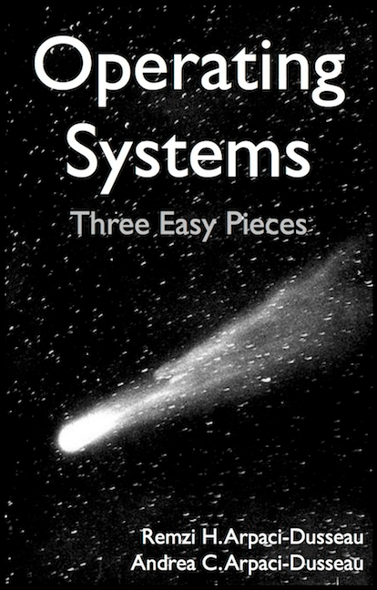
Textbook - Required
Operating Systems: Three Easy Pieces
Remzi H. Arpaci-Dusseau Andrea C. Arpaci-Dusseau
http://pages.cs.wisc.edu/~remzi/OSTEP/
FREE
Notes:
End-of-chapter exercises are excellent exam study material

Slide 8
Other materials
Papers
Listed on schedule, some required, some optional
References from the OSTEP book
Recent conferences
Papers of note
Write a two-paragraph review for each required paper
Also FREE, and/or available via lib.ncsu.edu
…

Slide 9
Other materials
Xinu OS
https://xinu.cs.purdue.edu/
VCL image for Xinu development
References from the OSTEP book
Recent conferences
Papers of note
Also FREE
Book: “Operating System Design: The Xinu Approach”, Douglas Comer
The book is not free, but consider getting your own copy.

Slide 10
Grade Components
Projects – 40%
Four Xinu projects, one optional project
Midterm - 20%
Midterm: in class Oct. 8
Final – 25%
Final: 6-9PM Dec. 12
Paper reviews, class discussion – 15%

Slide 11
Grading Policy
Submit your own work
https://theory.stanford.edu/~aiken/moss/
No late submissions

Slide 12
Today
Intro to OS

Slide 13
What happens when a program runs?
Program loaded from some storage medium
Executes one instruction after another:
Fetch
Decode
Execute

Slide 14
What is an Operating System?
application (user)
operating system
hardware
OS makes it easy to run programs
Run many programs at once (seemingly)
Share memory among programs
Enable interaction with devices, etc.
Correctly and efficiently
A virtual machine, standard library, resource manager

Slide 15
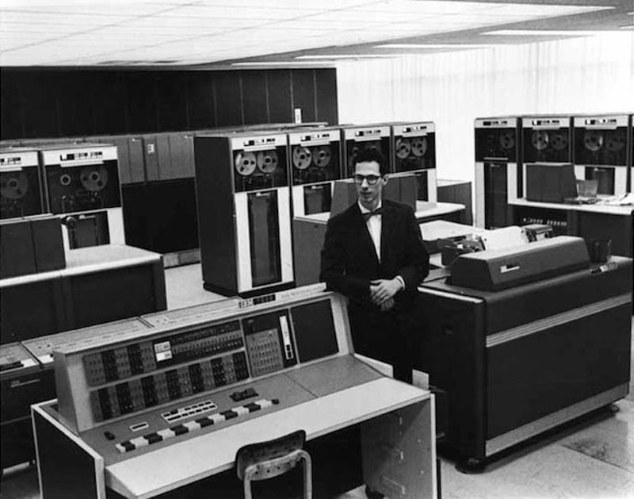
https://www.computerhistory.org/timeline/software-languages/#169ebbe2ad45559efbc6eb3572055b83
Fernando Corbato https://www.youtube.com/watch?v=Q07PhW5sCEk
Notes:
Virtualization

Slide 16
The illusion of many many CPUs ----CPU virtualization
To OS, only limited number of CPUs
A running program thinks it owns one CPU

Slide 17
Abstraction: Processes
A process is a system abstraction:
illusion of being the only job in the system
Mechanism? Policy?
user: application
create, kill processes,
inter-process comm.
operating system: process
multiplex resources
hardware: computer
Notes:
Mechanism:
Creation, destruction, suspension, context switch, signalling, IPC, etc.
Policy:
Minor policy questions:
Who can create/destroy/suspend processes?
How many active processes can each user have?
Major policy question that we will concentrate on:
How to share resources between multiple processes?

Slide 18
int main(int argc, char *argv[]) {
if (argc != 2) {
fprintf(stderr, "usage: cpu <string>\n");
exit(1);
}
char *str = argv[1];
while (1) {
printf("%s\n", str);
Spin(1);
}
return 0;
}

Slide 19
OS as a resource manager
Mechanism:
Creation, destruction, suspension, context switch, signalling, IPC, etc.
Policy:
Minor policy questions:
Who can create/destroy/suspend processes?
How many active processes can each user have?
Major policy question that we will concentrate on:
How to share resources between multiple processes?

Slide 20
int main(int argc, char *argv[]) {
if (argc != 2)
…
int *p = malloc(sizeof(int));
assert(p != NULL);
printf("(pid:%d) addr of p: %llx\n", …);
printf("(pid:%d) addr stored in p: %llx\n", …);
*p = atoi(argv[1]);
while (1) {
Spin(1);
*p = *p + 1;
printf("(pid:%d) value of p: %d\n", getpid(), *p);
}
return 0;
}

Slide 21
The illusion of private address space ----Memory virtualization
To OS, physical memory is shared
A running program thinks it has all to itself

Slide 22
Abstraction: Virtual memory
Virtual memory is a memory abstraction: illusion of large contiguous memory, often more memory than physically available
Mechanism? Policy?
application: address space
virtual addresses
operating system: virtual memory
physical addresses
hardware: physical memory
Notes:
Mechanism:
Virtual-to-physical memory mapping, page-fault, etc.
Policy:
How to multiplex a virtual memory that is larger than the physical memory onto what is available?
How to share physical memory between multiple processes?

Slide 23
OS as a resource manager
Mechanism:
Virtual-to-physical memory mapping, page-fault, etc.
Policy:
How to multiplex a virtual memory that is larger than the physical memory onto what is available?
How to share physical memory between multiple processes?

Slide 24
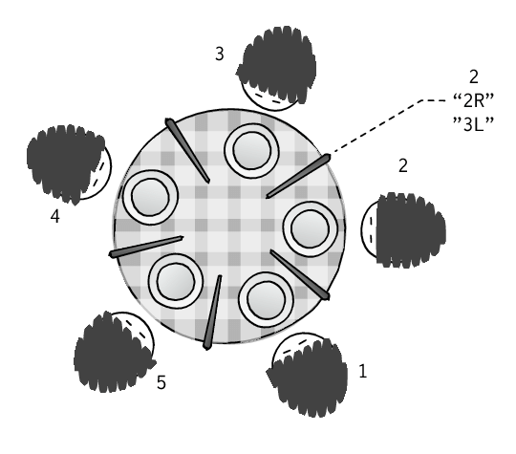
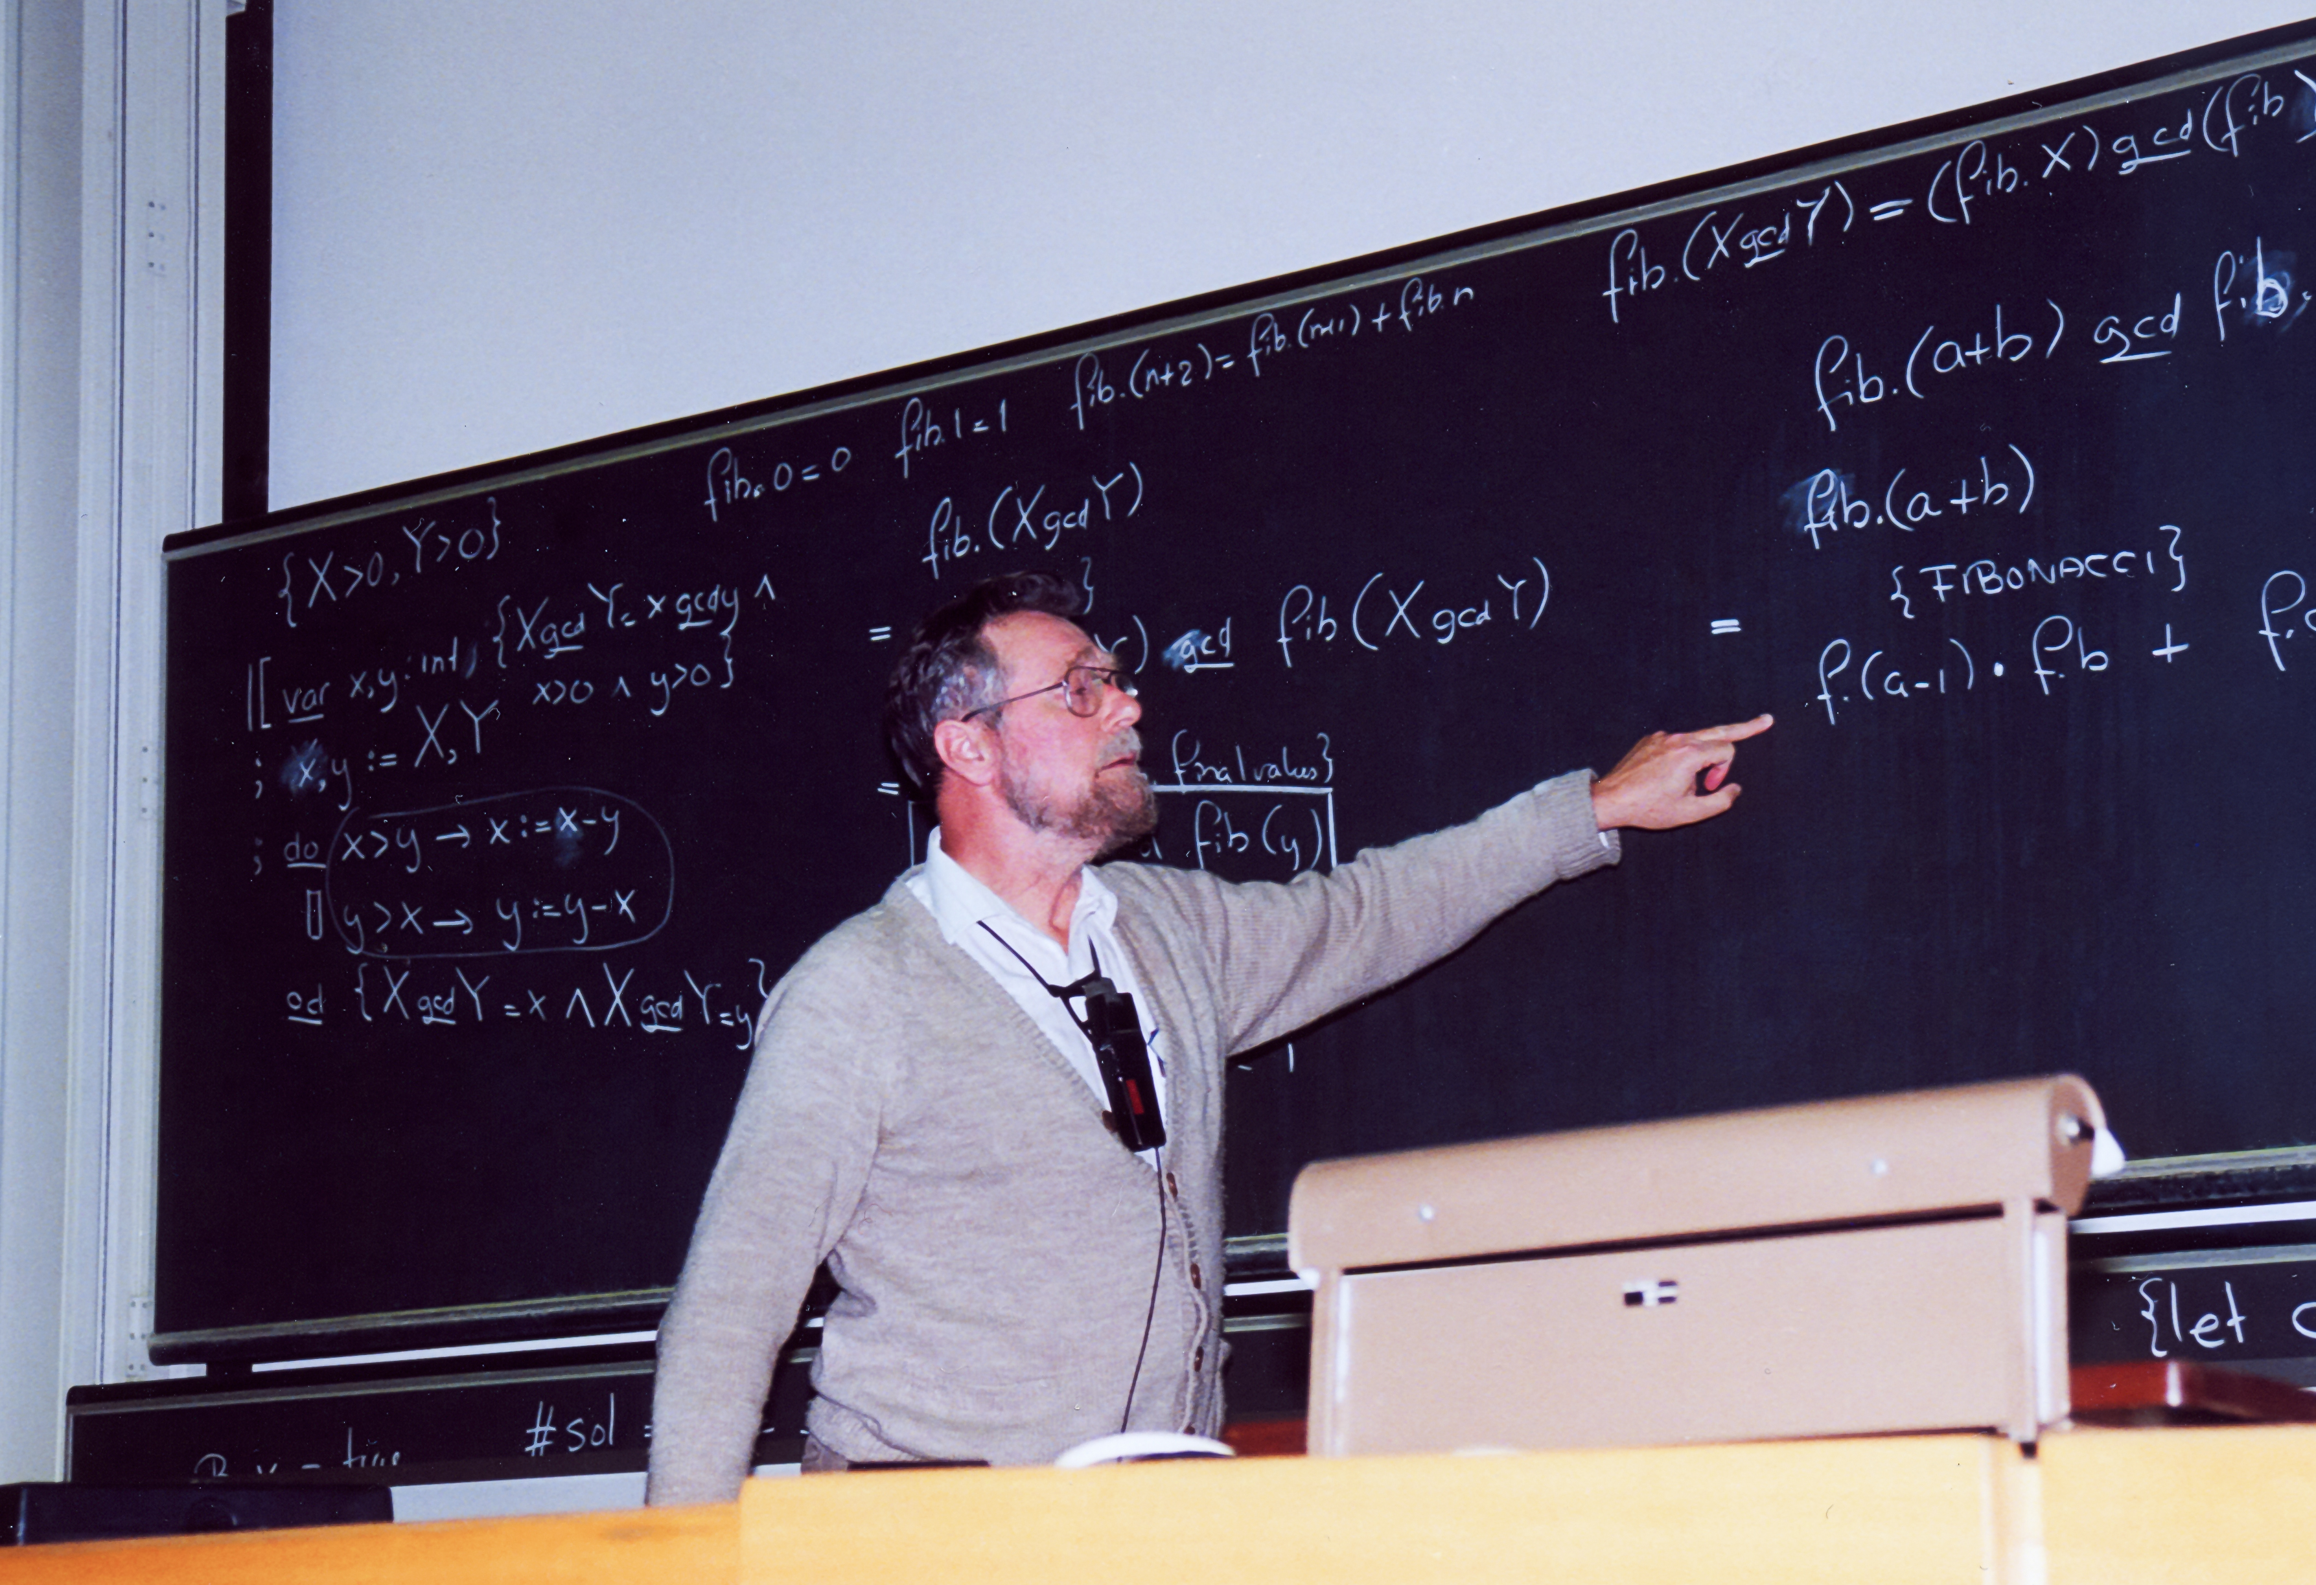
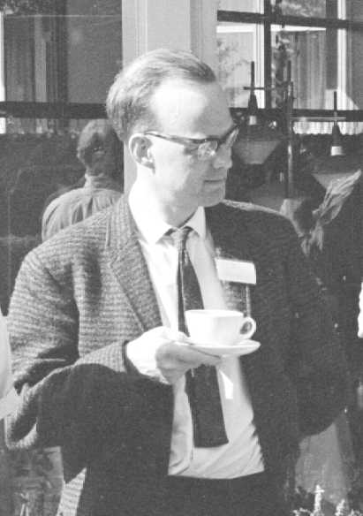
Edsger Dijkstra
The “Dining Philosophers” Problem
C.A.R. “Tony” Hoare
Dijkstra: By Andreas F. Borchert, CC BY-SA 4.0, https://commons.wikimedia.org/w/index.php?curid=14942745
Hoare: http://homepages.cs.ncl.ac.uk/brian.randell/NATO/N1969/HOARE.html

Slide 25
Abstraction: Thread
A thread is a processor abstraction:
illusion of having 1 processor per execution context
Mechanism? Policy?
application: execution context
create, kill, synch.
operating system: thread
context switch
hardware: processor

Slide 26
int main(int argc, char*argv[]) {
if (argc != 2) {
fprintf(stderr, "usage: threads <value>\n");
exit(1);
}
loops = atoi(argv[1]);
pthread_t p1, p2;
printf("Initial value : %d\n", counter);
Pthread_create(&p1, NULL, worker, NULL);
Pthread_create(&p2, NULL, worker, NULL);
Pthread_join(p1, NULL);
Pthread_join(p2, NULL);
printf("Final value : %d\n", counter);
return 0;
}
volatile int counter = 0;
int loops;
void *worker(void *arg) {
int I;
for (i = 0; i < loops; i++) {
counter++;
}
return NULL;
}

Slide 27
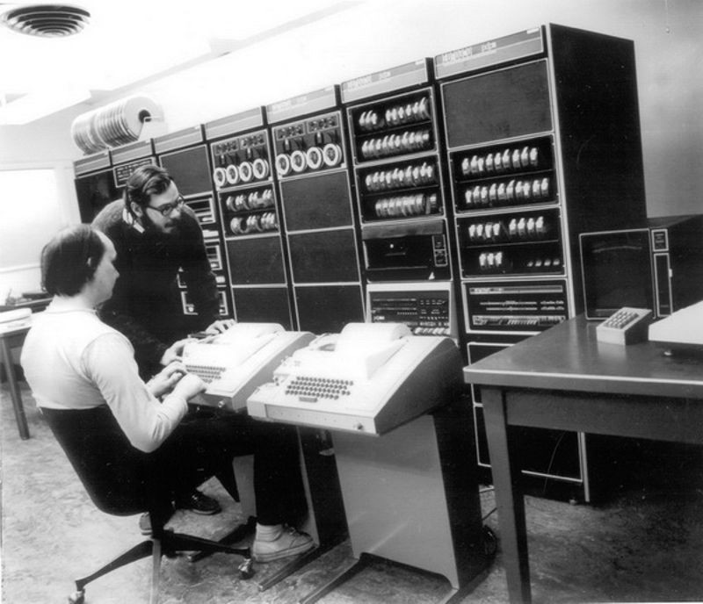

Slide 28
Persistence
Hardware: hard drives
Software: file systems
Tedious to deal with hardware details
OS does it for you as a library

Slide 29
Abstraction: file
A file is a storage abstraction:
illusion of structured storage space
Mechanism? Policy?
application/user: copy file1 file2
naming, protection,
operations on files
operating system: files, directories
operations on disk
blocks
hardware: disk
Notes:
Mechanism:
Naming, protection, operations on files
Different data structures
Policy:
When to write to disk?
How to order accesses?
Where to write on the disk?

Slide 30
int main(int argc, char*argv[]) {
int fd = open("/tmp/file”,
O_WRONLY | O_CREAT | O_TRUNC, S_IRWXU);
assert(fd > -1);
int rc = write(fd, "hello world\n", 13);
assert(rc == 13);
close(fd);
return 0;
}

Slide 31
OS as a resource manager
Mechanism:
Naming, protection, operations on files
Different data structures
Policy:
When to write to disk?
How to order accesses?
Where to write on the disk?

Slide 32
Design goals
Now we know what an OS does: 1, 2, and 3.
Providing abstractions
Good performance
Protection, isolation
Reliability
Energy-efficient
Security
Mobility
…

Slide 33
Course Topics Revisited – Questions?
Virtualization
CPU: process, “time-sharing”
Memory: virtual memory, “space-sharing”
Concurrency
CPU: thread(s)
Memory: locks, semaphores, condition variables
Network: sockets, go channels
Persistence
Long-Term Memory: file

Slide 34
CSC 501: Why Bother?
Learn resource management
Learn good design
Learn systems
Learn how to troubleshoot
Notes:
Not surprisingly, drivers dominate the total amount of source code, accounting for over 50% of all code. The architectural-dependent code (arch) is another substantial contributor, accouting for almost 20%. Both the file system and networking stacks account for about 7% each, though the file system used to play a much more prominent role. Memory management code is insubstantial.

Slide 35
When you have good abstractions…
“Growth of the Linux Code Base”
- http://pages.cs.wisc.edu/~remzi/Linux/

Slide 36
For the next lecture
OSTEP chapters on Virtualization, pp 21-63
Dialogue, Processes, Process API, Direct Execution
Read "On building systems that will fail” – Corbato’s Turing Award speech
http://larch-www.lcs.mit.edu:8001/~corbato/turing91/
First assignment is posted
https://people.engr.ncsu.edu/gjin2/Classes/501/Fall2019/assignments/PA0/pa0.html
Choose your due date: 9/6, 5pm, or 9/7 4am (Jin)

